Slide 1

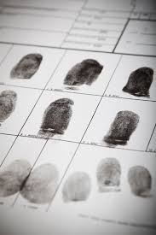
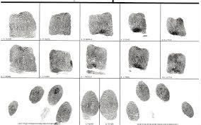

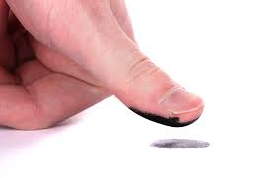
Now offering
fingerprinting services!
Class 3 Items
Employment
Passports
Security Licensing
Background Checks
Conceal Carry Permits
(For Non-Resident Permits Only)
Child Safety Programs
Just $25 per set
***Call for Appointment

